Slide 1
K.RAMAKRISHNAN COLLEGE OF ENGINEERING
Team members:
B. Usha
R. Sruthi
S. Priyadharshini

Slide 2
EXAMINATION MANAGEMENT SYSTEM
OBJECTIVE :
The system being developed is economic with respect to School or College’s point of view.
The main objective of this project is to reduce the workload of the school or college management by selecting the students for the exam based on the eligibility criteria.
The eligibility criteria includes the student’s attendance percentage , whether the student paid the exam fees or not and based on that it concludes the student to write the exams.

Slide 3
OPERATIONS:
Software for Examination Management System that can perform the following operations:
Add/Delete the Details of the Students
Attendance Monitoring of the students
Set/Edit Eligibility criteria for exams
Check Eligible Students for Exams
Print all the records of the students

Slide 4
MODULES
Execute(): This function will shows the available choices for the software and will perform the below functionality using Switch Statements
Functionality: Add Student DetailsShow Eligible StudentsDelete Student RecordUpdate Eligibility CriteriaPrint Details of Students

Slide 5
eligibleStudents(): This function shows the previous attendance percentage required for exams and get the data from the user and update the eligibility for the exams.It also updates the fee status required for the eligibility of exams by iterating over the List of the student records and for every student check the attendance percentage is above the percentage required and fee status of the student.
print_student(): This function iterate over the list of students and print the details of the student.
delete(): This function get the student roll number to delete the student record and update the student’s list.

Slide 6
add(): This function that get the data from the user and update the list of the students.While adding the student into the list, check for the uniqueness of the Roll Number of the student.
Details of the students to be added are: Name of Student
Roll Number
Fees Status
Attendance Record of student

Slide 7
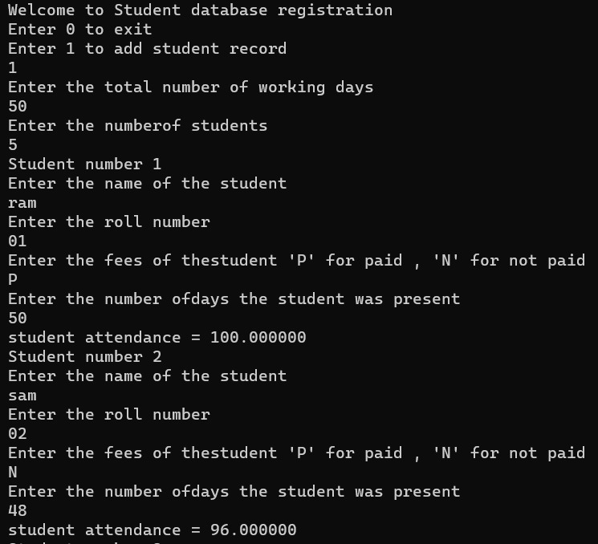
OUTPUT SCREENSHOTS: For Adding Student’s Details:

Slide 8
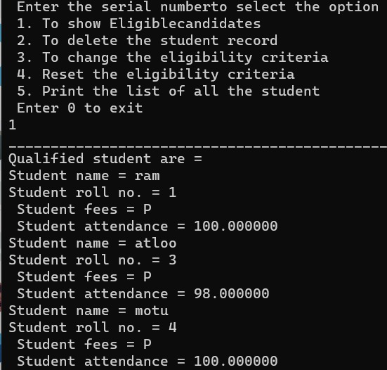
For Eligible Students:

Slide 9
THANK YOU

